Slide 1

Demographic Report
Edem Dziko :
Notes:
My name is Edem Dziko and this is my presentation on the census data

Slide 2
Scope of Presentation
Scope
01
Background & Report Objectives
02
Data Cleaning Tools
03
Data Cleaning Process
04
Insights from Data
05
Next Steps?
Notes:
These are the various items I will be peaking about

Slide 3
1
Report Background
This report seeks to understand the demographics of a modest town in 1881 UK.
2
Report Objectives
To clean, analyse and provide some visualisations on the census data
To make data driven decisions on what to do with a vacant piece of land and what investment expenditure to carry out.
Notes:
To start with, the sets out to understand the demographics of a small town in eighteen eighty one UK
At the end of the Report, It is my aim to make data driven decisions on what to do with a vacant piece of land and what investment expenditure to carry out.

Slide 4
Data Cleaning Tools
Scope
1
Python
2
Pandas
3
Pivot Tables
4
Seaborn & Matplotlib
Notes:
These are the tools I used in my work

Slide 5
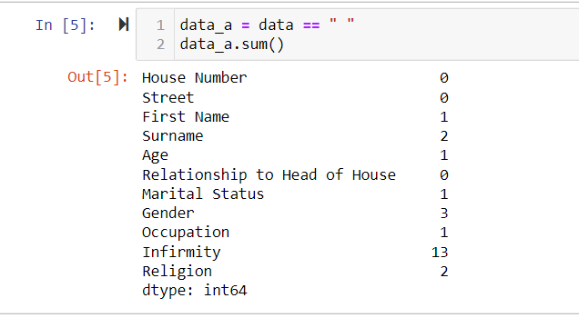
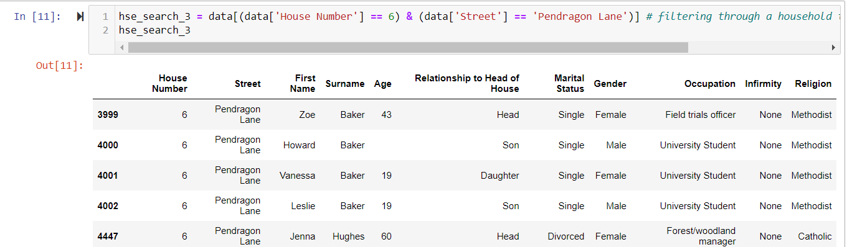
Data Cleaning Process
1
Detecting and filling out all white spaces within the dataframe
Notes:
Under detecting and filing out white spaces, 8 columns out of 11 columns had whitespaces which needed attention.
This one talks about a house search I filtered to determine the age of howard

Slide 6
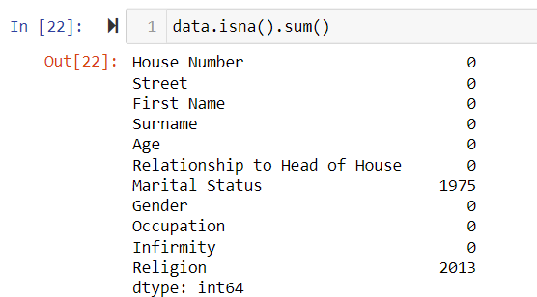
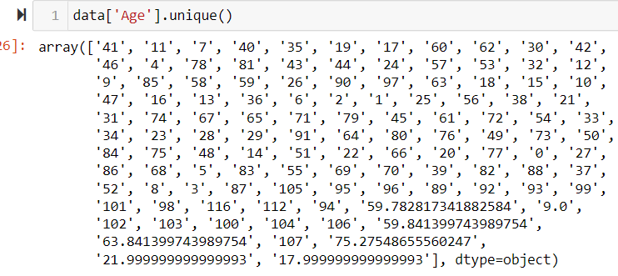
Data Cleaning Process
2
Cleaning null contents from the Marital Status column
All 1974 entries for children aged below 18 were still left as null values
1 entry for persons aged above 17 was changed as ‘Single’
Notes:
Under cleaning step 2, I searched for null values in Marital status and realised that one thousand nine hundred and seventy five entry had null values.
And to clean this I needed to correct the anomalies in the age data since some values shows as int and others as float.
Afterwards, I realised that 1 person, above 17 yrs had a null value which was converted as single and all others were children hence remained as null

Slide 7
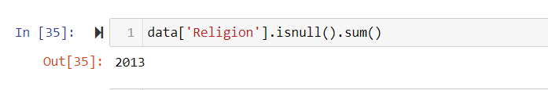
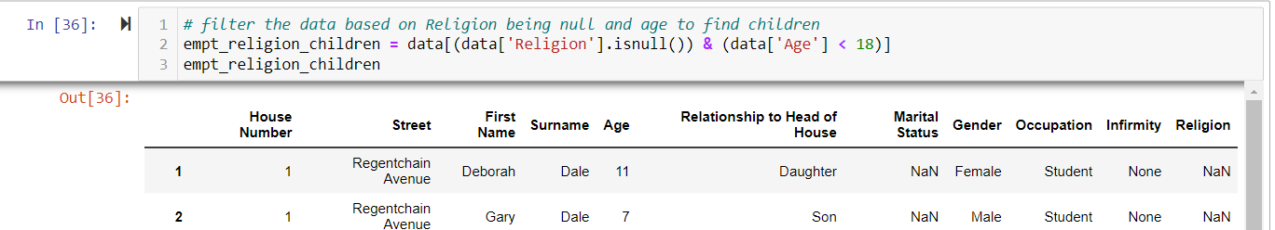


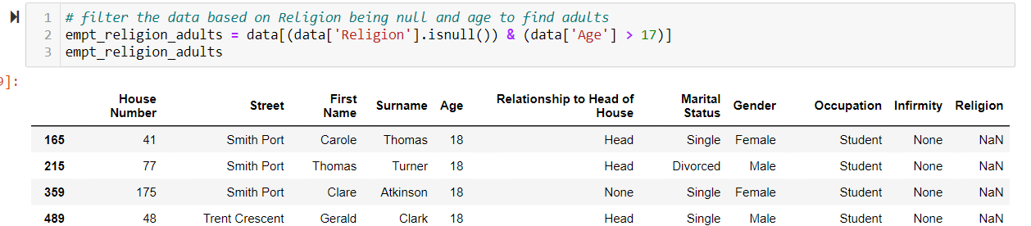
Data Cleaning Process
3
Cleaning null content from the Religion column
Notes:
Two thousand and thirteen entries came out as null under religion. Those under 18 were still left as null due to UK regulation.
All others thus those above 17yrs were converted as none after house searches provided little assistance

Slide 8
Data Cleaning Process
4
Checking, analysing the data integrity as per the set out rules and procedures
a
Married / Divorced Children
b
Retiree as unemployed
c
‘Housekeeper & Private’ as Religion
d
Head of house aged below 18
Notes:
Here, I checked the various columns and its contents.
Under a) I found some children who were married or divorced, these could have been the case in 1881 if parental consent was given
b) Persons aged over 65 which previously showed as unemployed were changed to retired.
c)Housekeeper and private were identified as personal errors hence computed as none
d) Head of house aged below 18 were identified to have the same content in (a) above

Slide 9
Data Cleaning Process
5
Grouping data to aid in data analysis
a
Created an age band column
b
Segregated Occupation into 6 groups
Notes:
I created these two groupings to aid analysis

Slide 10
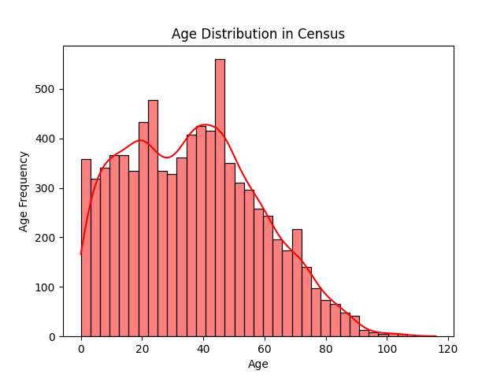

Data Insights
Age Distribution in Census
Signifies a huge commuting populace since the distribution is more dense in the school going age, and the working class age.
Maybe a Train station will be a good investment for the piece of land
Increase spending on school?
Notes:
My first data insight is the age distribution graph . Which shows that population is more dense around school going and working class age.
To build a train station or increase school spending

Slide 11
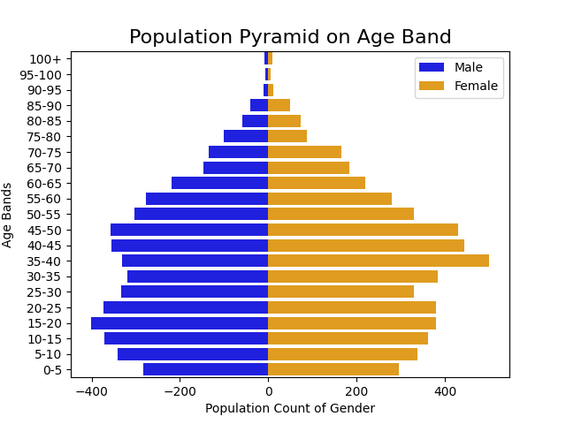
Data Insights
Population Pyramid on Age Band
This slides justifies the earlier submission from the age distribution plot above.
Also it looks like population decreases as people age but it not conclusive yet on the type of housing to build
Notes:
The age pyramid also looks at population decreasing after 55yrs. Well for obvious reasons death, migration but I‘m yet to calculate these.

Slide 12
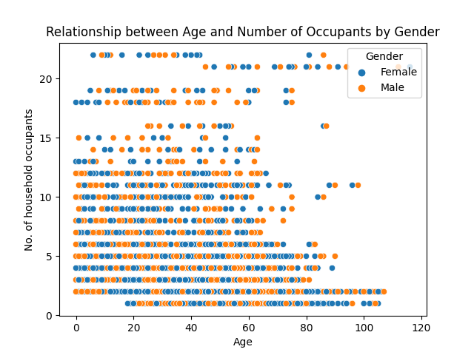
Data Insights
Relationship between Age & No. of Occupants
Its surprising how the oldest people in the town are in a house with 19 other people. Maybe investment should centre on old age care.
Again there is quite a people aged over 85 who live in a single or double occupant home.
Notes:
The relationship between age and number of occupants, I realised that theoldest people aged 112 and 116 both live in a 21 occupancy house. So maybe we may have to look at investing in elderly care
Again, there is quite a lot of people aged over 85 who live with themselves or one other person which is definitely not the best for their welfare.

Slide 13
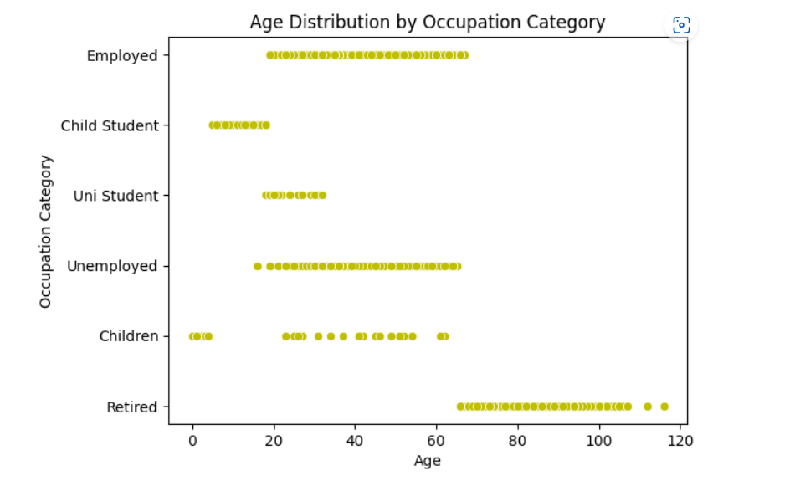
Data Insights
Age Distribution by Occupation Category
Shows the need to invest in employment and training
Again, investment in old age care
Train station for commuters.
Notes:
This scatterplot shows us that, there is a need for us to invest also in employment and training.
Also there is a high evidence of commuters from employed and university students(even though we cannot tell emphatically which amt of employed people commute)

Slide 14
Next Steps
Scope
Death Rate Calculation
Analysis on Migration
Divorce & Marriage rates
3
6
5
2
Final Report on Census
Computation of Birth Rate
1
4
Religion & Infirmities
Notes:
My next steps will be to look at these, to further understand the data and answer the questions with regards to the plot of land and the investment to carry out.
Thank you

Slide 15
Data Insights
Thank You

